Slide 1

Filter Function

Slide 2
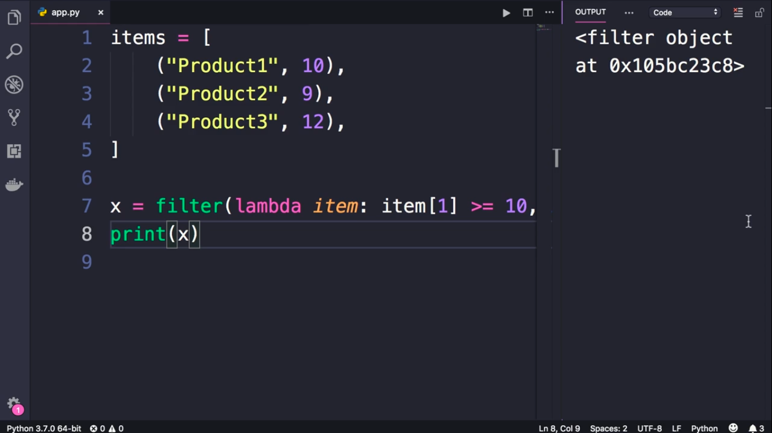

Slide 3
